Slide 1

Regression
Lecture 6 Instruction
Introduction to Data Science (IDS) course

Slide 2
Simple Linear Regression Example
Height (cm) | Weight (kg)
160 | 57
162 | 54
167 | 64
175 | 71
175 | 73
180 | 70
180 | 76
182 | 74
185 | 82
190 | 94
Exercise: Calculate a linear regression model that predicts the weight of a student based on their height

Slide 3
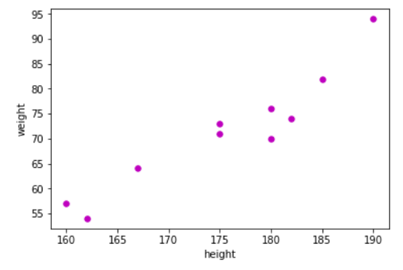
Simple Linear Regression Example
Height (cm) | Weight (kg)
160 | 57
162 | 54
167 | 64
175 | 71
175 | 73
180 | 70
180 | 76
182 | 74
185 | 82
190 | 94
First we plot the data

Slide 4

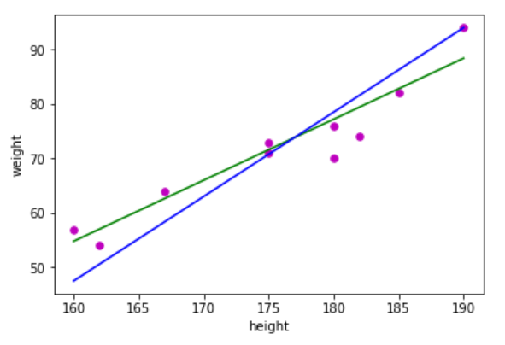
Simple Linear Regression Example
Height (cm) | Weight (kg)
160 | 57
162 | 54
167 | 64
175 | 71
175 | 73
180 | 70
180 | 76
182 | 74
185 | 82
190 | 94
We try to fit a linear function to our data points:

Slide 5


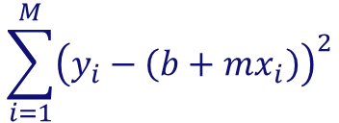
Simple Linear Regression Example
But which line fits our data best?
Blue:
Green:
We calculate the sum of squared errors and pick the function that reports the smaller value

Slide 6


Simple Linear Regression Example
Blue:
Green:
x | y | Model prediction | Error | Squared Error
160 | 57 | 47.5 | 9.5 | 90.25
162 | 54 | 50.6 | 3.4 | 11.56
167 | 64 | 58.35 | 5.65 | 31.92
175 | 71 | 70.75 | 0.25 | 0.06
175 | 73 | 70.75 | 2.25 | 5.06
180 | 70 | 78.5 | -8.5 | 72.25
180 | 76 | 78.5 | -2.5 | 6.25
182 | 74 | 81.60 | -7.60 | 57.76
185 | 82 | 86.25 | -4.25 | 18.06
190 | 94 | 94 | 0 | 0
x | y | Model prediction | Error | Squared Error
160 | 57 | 54.79 | 2.21 | 4.88
162 | 54 | 57.03 | -3.03 | 9.18
167 | 64 | 62.63 | 1.37 | 1.88
175 | 71 | 71.59 | -0.59 | 0.35
175 | 73 | 71.59 | 1.41 | 1.98
180 | 70 | 77.19 | -7.19 | 51.70
180 | 76 | 77.19 | -1.19 | 1.42
182 | 74 | 79.43 | -5.43 | 29.48
185 | 82 | 82.79 | -0.79 | 0.62
190 | 94 | 88.39 | 5.61 | 31.47
Sum = 293.17
Sum = 132.96

Slide 7
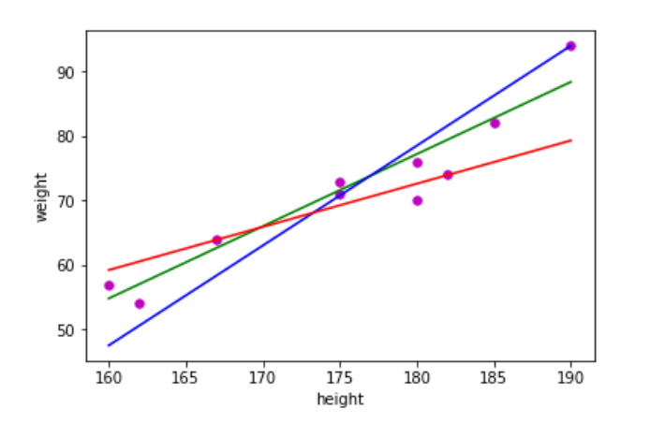

Simple Linear Regression Example
Your turn!
Calculate the sum of squared errors for the red function:
Red:

Slide 8
Simple Linear Regression Example
This approach is not feasible in reality!
We would need to try an infinite number of possible lines.
We need a different approach!

Slide 9
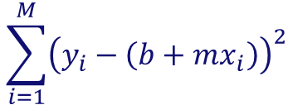

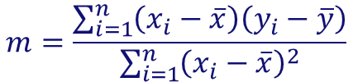




Simple Linear Regression Example
We make use of the sum of the squared error.
By minimizing this equation we get the least squares estimates for m and b.
: observed target value for data point i
: value of independent variable of data point i
: mean of all observed y-values
: mean of all observed x-values

Slide 10


Simple Linear Regression Example
We find our linear regression function:

Slide 11
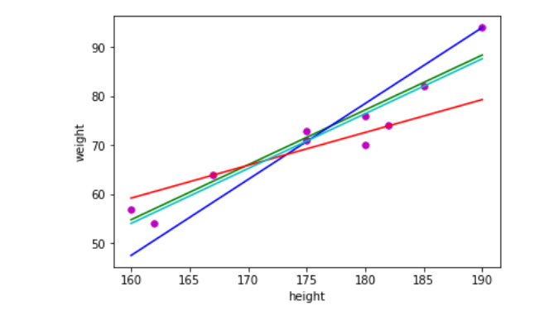

Simple Linear Regression Example
Also plotting the regression line
shows that it fits the data points best.
Shown in cyan colour.

Slide 12
Simple Linear Regression Example
Investments (Million Euro) | Sales (Million Euro)
23 | 651
26 | 762
30 | 856
34 | 1,063
43 | 1,190
Your turn!
Minimize the squared error function to calculate the linear regression function that predicts the sales value based on the investments made.

